Slide 1
Graph

Slide 2
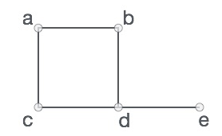
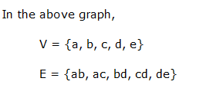
Graph
A graph is a collection of nodes called vertices and collection of segments called line or edges
A graph is a pictorial representation of a set of objects where some pairs of objects are connected by links
Formally, a graph is a pair of sets (V, E), where V is the set of vertices and E is the set of edges, connecting the pairs of vertices. Take a look at the following graph
G(V,E)

Slide 3
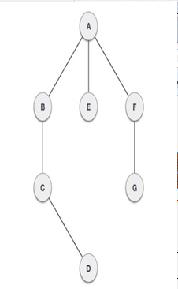
Definitions
Vertex − Each node of the graph is represented as a vertex. labeled circle represents vertices. So A to G are vertices
Edge − Edge represents a path between two vertices or a line between two vertices. lines from A to B, B to C and so on represents edges
Adjacency − Two node or vertices are adjacent if they are connected to each other through an edge. B is adjacent to A, C is adjacent to B and so on
Path − Path represents a sequence of edges between two vertices. In example given below, ABCD represents a path from A to D

Slide 4
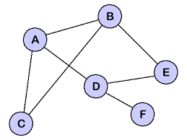
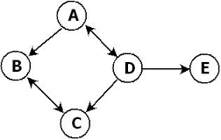
Definitions
Cycle: A cycle is path that consists of at least three vertices that starts and end at same vertex. Here ABC,ABDE are cycle
Loop: A special case of cycle in which a single arc begins and end with the same vertex
Directed graph or digraph: each edge has direction to its successors
Undirected Graph: No direction on any line
Connected Graph: Two vertices are connected if there is a path between them. A graph is said to be connected if ignoring direction there is a path from any vertex to any other vertex

Slide 5
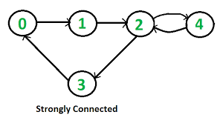
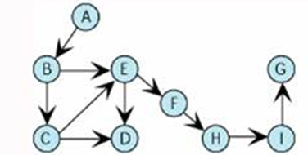
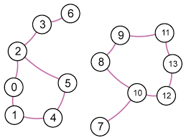
Definitions
Strongly Connected: A directed graph is strongly connected if there is a path from each vertex to other vertex
Weakly connected : A directed graph is weakly connected if at least two vertices are not connected
Disjoint Graph: if graph is not connected

Slide 6
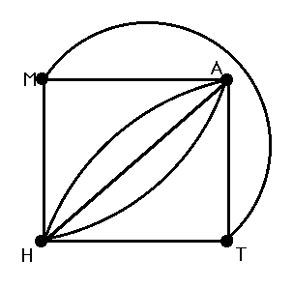
Definitions
Degree: the degree is to count the number of edges which has that vertex as an endpoint. The degree of the graph will be its largest vertex degree. The degree of the graph is 5.
Indegree : the number of edges entering the vertex of bigraph
Outdegree : the number of edges leaving the vertex of bigraph
Vertex | Degree
M | 3
A | 5
T | 3
H | 5

Slide 7
Operations
Add vertex
Inserting a new vertex
Delete vertex
Remove all connecting edge
Add edge
Delete Edge
Find Vertex
Traverse Graph
Depth-first Traversal
Breadth-first Traversal

Slide 8
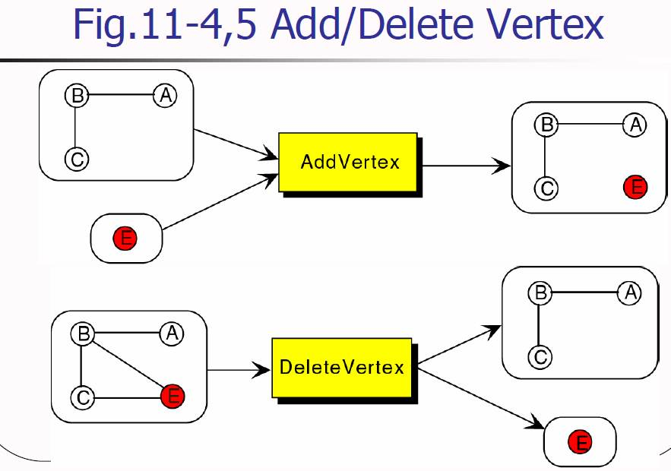

Slide 9
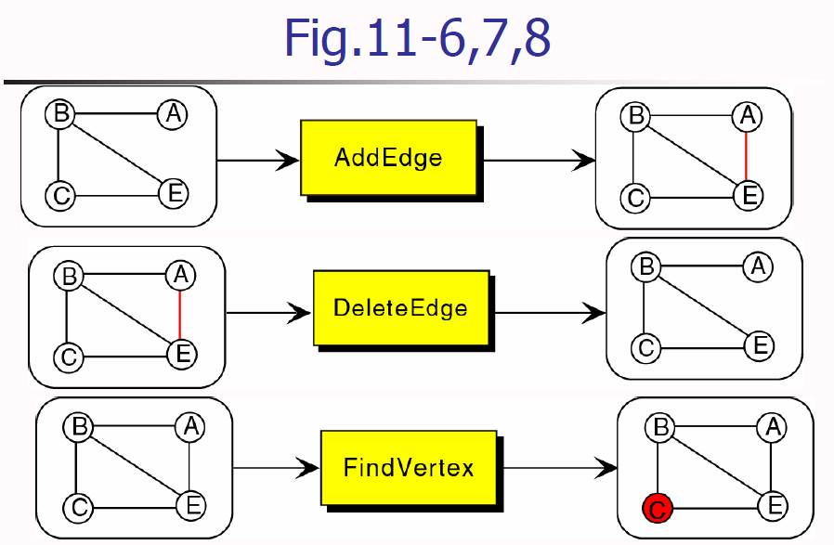

Slide 10
Traversals
New challenge – a vertex in a graph having multiple parents
Possible to have different paths to a vertex
Goals – to assure processing the data
To use a “visited flag”
Set all flags off initially
Set the flag of a vertex on when paying a visit

Slide 11
Depth-First Traversal
All of a vertex’s descendants are processed before we move to an adjacent vertex.
Steps
Process the first vertex of the graph
Select any vertex adjacent to the first vertex and process
Select and process any adjacent vertex until reaching a vertex with no adjacent vertex

Slide 12
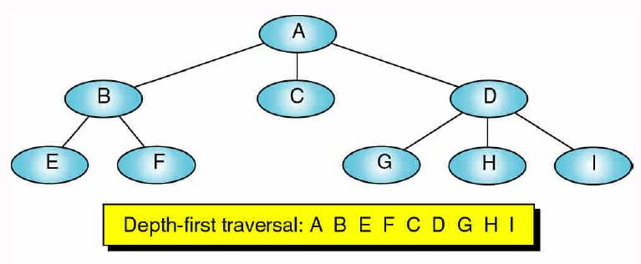
Fig.11-9 Depth First Traversal

Slide 13
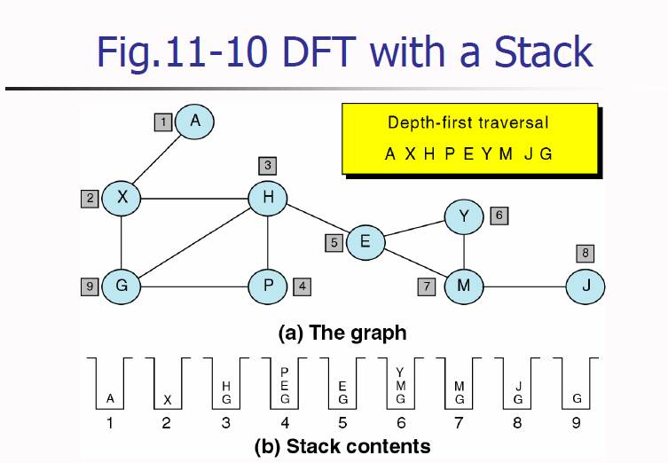

Slide 14
Breadth-First Traversal
All adjacent vertices of a vertex are processed before going to the next level.
Steps
Process the first vertex of the graph
Process all the of its adjacent vertices
Select the each adjacent vertex and process vertices adjacent it.
Repeat …

Slide 15
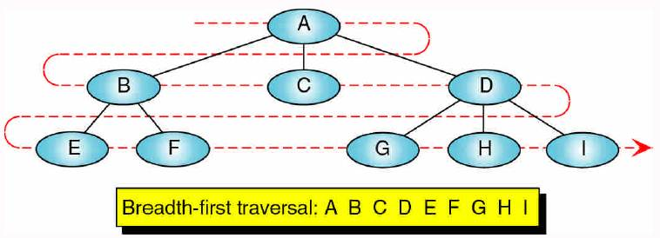
Fig.11-11 Breadth-First Traversal

Slide 16
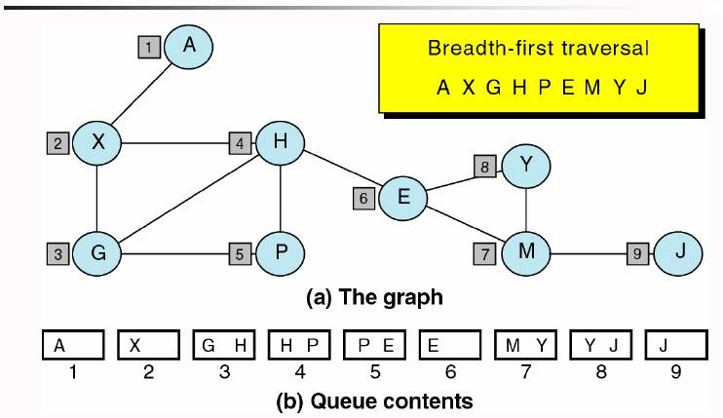
Fig.11-12 BFT with a Queue

Slide 17
Graph Storage Structures
Need to store two sets
Vertices
Edges
Data structures
Adjacent matrix
Adjacent list

Slide 18
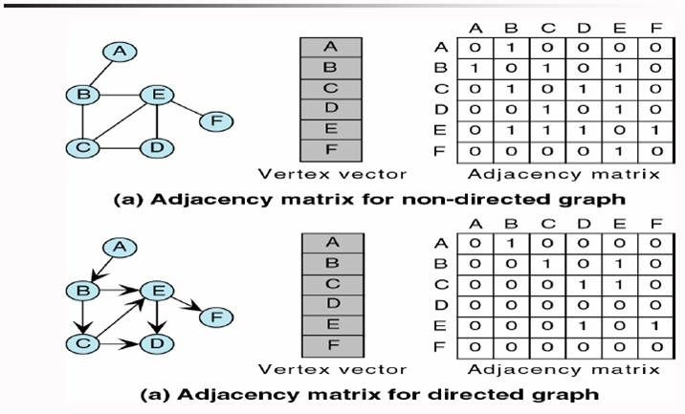
Fig.11-13 Adjacent Matrix

Slide 19
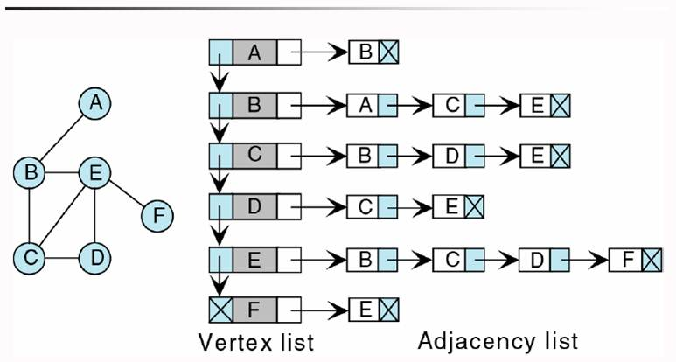
Fig.11-14 Adjacent List

Slide 20
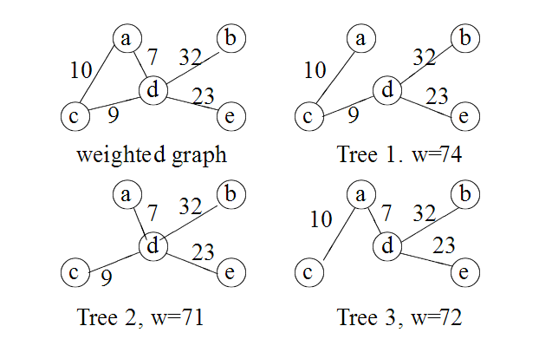
Weighted Graphs
A weighted graph is a graph, in which each edge has a weight (some real number).
Weight of a Graph: The sum of the weights of all edges

Slide 21
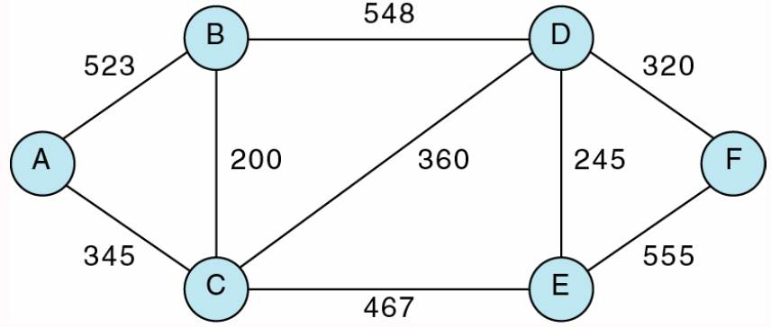
Networks
Graph with weighted arcs –Weighted Graph
Fig.11-18

Slide 22
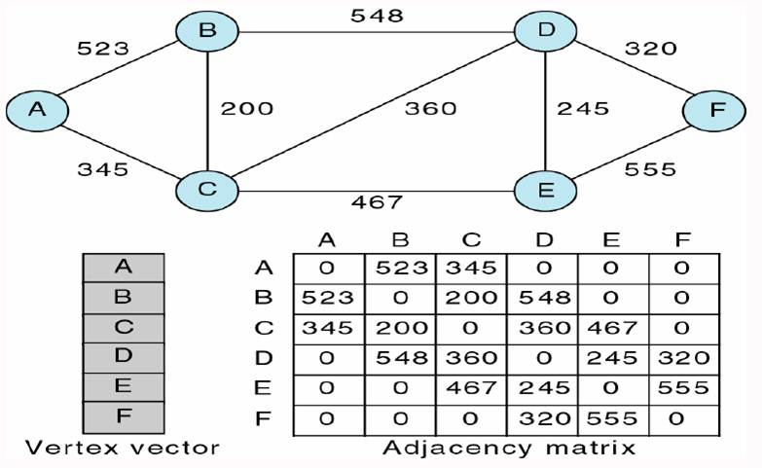
Fig.11-19 Adjacency Matrix

Slide 23
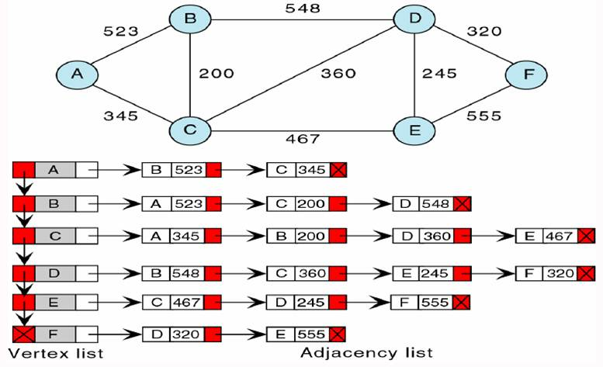
Fig.11-19 Adjacency List

Slide 24
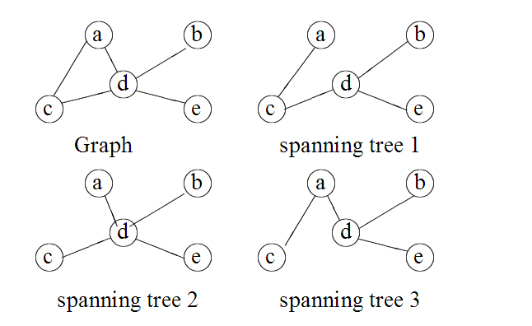
Minimum Spanning Tree
Spanning Tree
A subgraph of a connected undirected graph G is called spanning tree if the tree containing all of the vertices in the graph

Slide 25
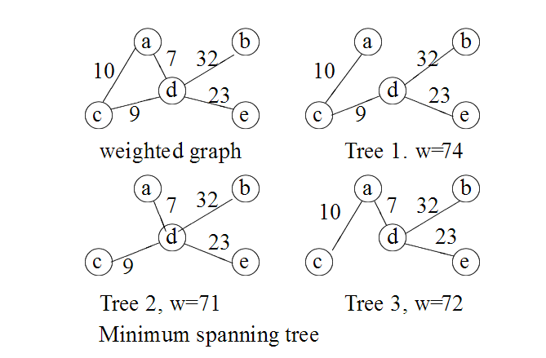
Minimum Spanning Tree
A Minimum Spanning Tree in an undirected connected weighted graph is a spanning tree of minimum weight (among all spanning trees).

Slide 26
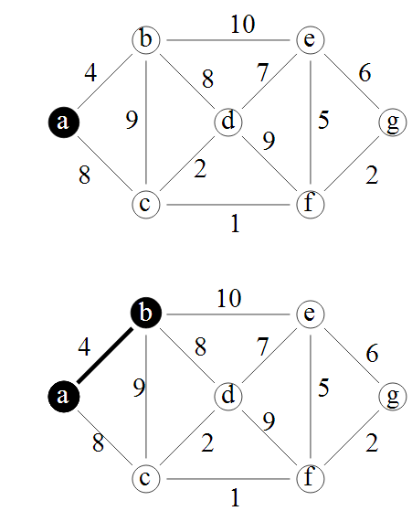
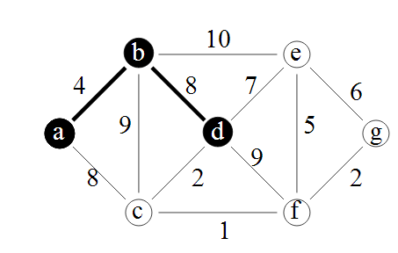
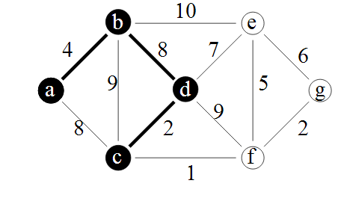
Minimum Spanning Tree

Slide 27
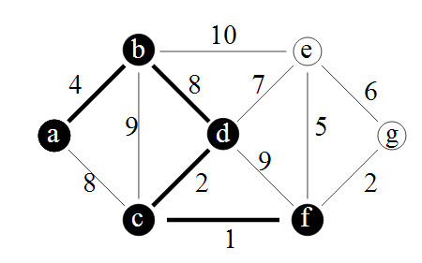
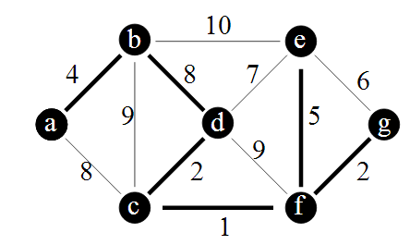
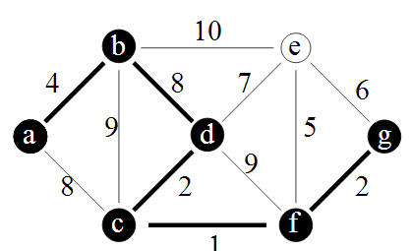
Minimum Spanning Tree

Slide 28
Shortest Path Algorithm
Finding the shortest path between two vertices in a network
Application: to find the least expensive route between home and our destination
Steps
Insert the first vertex into the tree
From every vertex already in the tree
Examine the total path length to all adjacent vertices not in the tree
Select the edge with the minimum total path weight and insert it into the tree
Repeat Step 2 until all vertices are in the tree

Slide 29
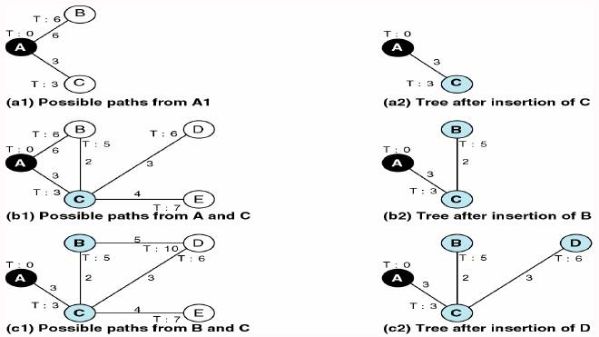
Fig.11-22

Slide 30
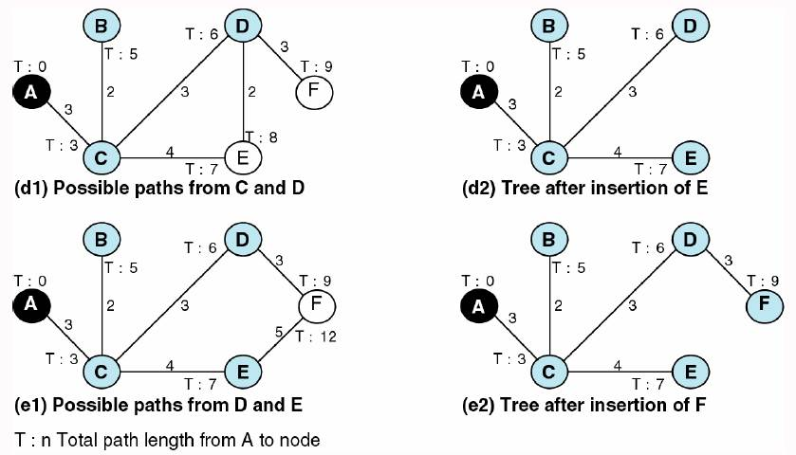
Fig.11-22 (cont.)

Slide 31
Applications of Graph Theory
Graph theory has its applications in diverse fields of engineering −
Electrical Engineering − The concepts of graph theory is used extensively in designing circuit connections. The types or organization of connections are named as topologies. Some examples for topologies are star, bridge, series, and parallel topologies.
Computer Science − Graph theory is used for the study of algorithms. For example,
Kruskal's Algorithm
Prim's Algorithm
Dijkstra's Algorithm
Computer Network − The relationships among interconnected computers in the network follows the principles of graph theory.
Science − The molecular structure and chemical structure of a substance, the DNA structure of an organism, etc., are represented by graphs.
Linguistics − The parsing tree of a language and grammar of a language uses graphs.
General − Routes between the cities can be represented using graphs. Depicting hierarchical ordered information such as family tree can be used as a special type of graph called tree.

